Slide 1
Computer Engineering 12 Class 17
Instructor: Yuhong Liu
Office: Bannan 324 F
Email: yhliu@scu.edu
Tel: 408-551-3513

Slide 2
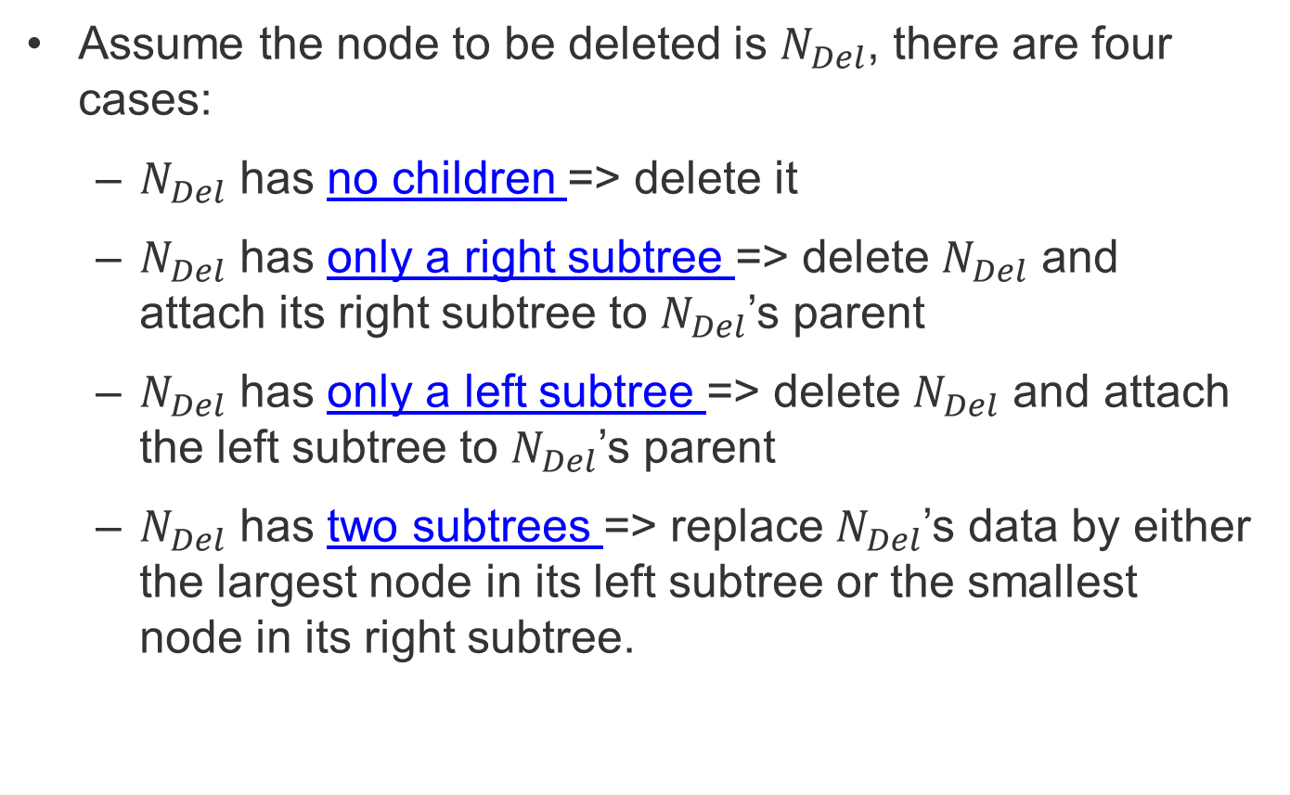
Review: BST - Deletion
Assume the node to be deleted is $N_{Del}$, there are four cases:
$N_{Del}$ has no children => delete it
$N_{Del}$ has only a right subtree => delete $N_{Del}$ and attach its right subtree to $N_{Del}$’s parent
$N_{Del}$ has only a left subtree => delete $N_{Del}$ and attach the left subtree to $N_{Del}$’s parent
$N_{Del}$ has two subtrees => replace $N_{Del}$’s data by either the largest node in its left subtree or the smallest node in its right subtree.

Slide 3
BST – Deletion Big-O
Delete node 3 or node 16
Delete node 14 or node 19
Delete node 6
What’s the worst-case big O?
O(h) +O(1) = O(h)
17
6
19
3
14
22
23
16

Slide 4
Let’s work on the code
One Challenge:
Deletion may change the structure of the subtree, leading to a different root of the subtree. How could we connect the parent with the new root of the subtree?
Solution: We pass the new root of the subtree (after deletion) back to the parent.

Slide 5
Deletion Code
NODE* deleteNode(NODE* root, int x, bool* found)
{
// base case
if (root == NULL)
{
*found = false;
return root;
}
// If the node to be deleted is smaller than the
//root's data, it lies in left subtree
if (x < root->data)
root->left = deleteNode(root->left, x, found);
// If the node to be deleted is greater than the
//root's data, it lies in right subtree
else if (x > root->data)
root->right = deleteNode(root->right, x, found);
// if x is same as root's data, this is the
//node to be deleted
else
{
*found = true;
//node with only one child or no child
if (root->left == NULL)
{
NODE* temp = root->right;
free(root);
return temp;
}
else if (root->right == NULL)
{
NODE* temp = root->left;
free(root);
return temp;
}
//node with two children: Get the
//smallest in the right subtree
NODE* temp = minimum(root->right);
//Copy the inorder successor's content to this node
root->data= temp->data;
// Delete the inorder successor
root->right = deleteNode(root->right, temp->data, found);
}
return root;
}
Notes:
How do you determine the root node is the key.

Slide 6

SET | Unsorted Array | Sorted Array | Hash Table | Unsorted Linked List | Sorted Linked List | BST
Search/Find | O(n) | O(log n) | O(n) (expected O(1)) | O(n) | O(n) | O(h) (Log(n) <= h <= n)
Add | O(n) + O(1) = O(n) | O(log n)+O(n) = O(n) | O(n) (expected O(1)) | O(n) + O(1) = O(n) | O(n) + O(1) = O(n) | O(h)+ O(1) = O(h)
Remove | O(n) + O(1) = O(n) | O(log n)+O(n) = O(n) | O(n) (expected O(1)) | O(n) + O(1) = O(n) | O(n) + O(1) = O(n) | O(h)+ O(1) = O(h)
Min/Max | O(n) | O(1) | O(m) | O(n) | O(1) (assuming fast access to tail) | O(h) (Log(n) <= h <= n)

Slide 7
A Question
How many tests do we need to do in order to locate node 52?
8
12
14
18
20
23
44
52
How can we make it easier?

Slide 8
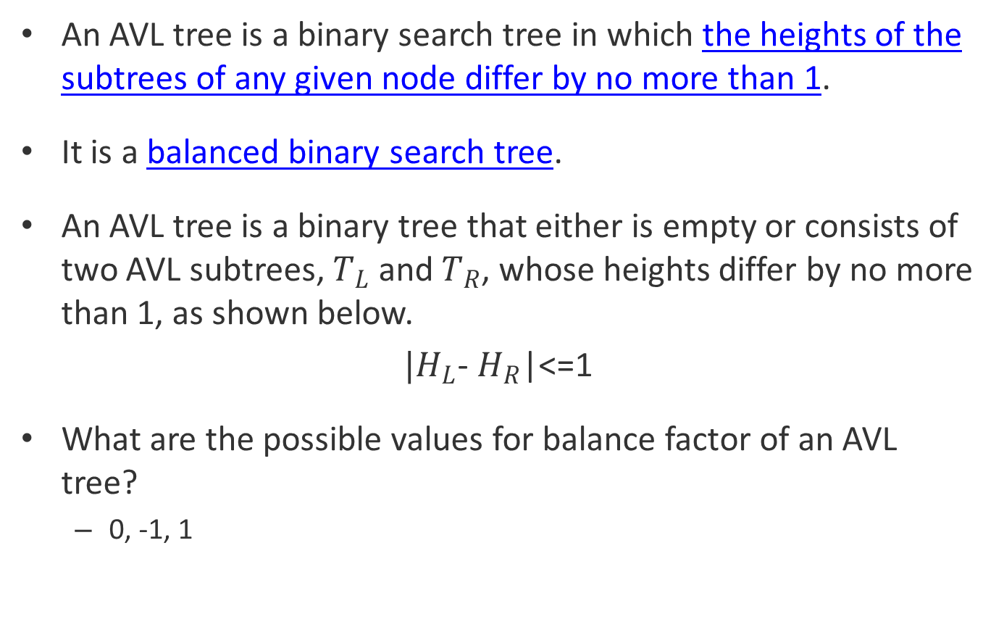
AVL Tree Definition
An AVL tree is a binary search tree in which the heights of the subtrees of any given node differ by no more than 1.
It is a balanced binary search tree.
An AVL tree is a binary tree that either is empty or consists of two AVL subtrees, $T_{L}$ and $T_{R}$, whose heights differ by no more than 1, as shown below.
$|H_{L}$- $H_{R}$|<=1
What are the possible values for balance factor of an AVL tree?
0, -1, 1

Slide 9
An Example
Step1: Check the value – BST
Step 2: Check the shape - Balanced binary tree
For each node, we use
LH to indicate that the left subtree is higher than the right subtree.
RH to indicate that the left subtree is shorter than the right subtree
EH to indicate that the subtrees are the same height.
LH (1)
LH(1)
23
18
44
RH (-1)
EH (0)
12
20
EH (0)
52
8
14
EH (0)
EH (0)
EH (0)
AVL tree ?

Slide 10
AVL Tree - Operations
The search and traversal of AVL tree is the same as BST.
What is the worst-case big-O run time for AVL tree search?
O(logn)
How about insertion & deletion?
They are different.
Why?
AVL tree is a balanced tree, while insertion/deletion may make it unbalanced.

Slide 11
AVL Tree – Insertion/Deletion
We can consider insertion as two steps
Insert the node at a leaf/ leaflike node - (the same as BST insertion)
Back out of the tree and balance each node.
We consider deletion as two steps
Delete the node - (the same as BST deletion)
Back out of the tree and balance each node.
Example:
18
18
12
12
Insert node 8
8

Slide 12
How to do Balance?

Slide 13
Four Cases for Rebalancing
Out of balance
Rotate right
Rotate left
18
18
Out of balance
LH (2)
RH (-2)
12
20
LH (1)
One Rotation
RH (-1)
8
EH (0)
24
Left of Left
EH(0)
Right of Right
Rotate right
Rotate left
Out of balance
18
Out of balance
18
RH (-2)
LH (2)
Two Rotations
Rotate right
Rotate left
24
8
LH (1)
RH(-1)
20
12
EH (0)
EH(0)
Left of Right
Right of Left

Slide 14
Meaning of Rotations (I)
Rotate to the left =>
Your original right child becomes your parent.
After rotation, you are the left child of your parent.
Rotate to the right =>
Your original left child becomes your parent.
After rotation, you are the right child of your parent.

Slide 15
Summaries
Starting from the newly inserted/deleted node, go back to the root of the entire tree. Along the path, calculate balance factor for each node and rebalance the unbalanced nodes one by one through rotations. (The order matters!)
For each unbalanced node:
Step 1. Identify it as one of the four cases (i.e. Left-of-left, right-of-right, left-or-right, right-of-left) by checking itself and its higher subtree. For example, if an unbalanced node is LH, and its left subtree is also LH, the case is left-of-left.
Step 2. Rotate nodes accordingly.
Step 3. Back out to handle another unbalanced node if there’s any.

Slide 16
Exercise I – Complex Rotation
Rotate left
18
Rotate right
18
RH (-2)
Insert 21
Insert 4
LH (2)
8
20
RH (-1)
12
20
LH (1)
19
24
8
14
LH (1)
LH (1)
21
4
EH
EH (0)
Insert 10
18
18
Insert 19
RH (-2)
LH (2)
8
20
8
24
LH (1)
RH (-1)
4
12
20
28
LH (1)
LH(1)
10
19
EH
EH

Slide 17
Exercise I – Complex Rotation
Rotate left
18
Rotate right
18
RH (-2)
Insert 4
Insert 4
LH (2)
8
20
RH (-1)
12
20
EH
LH (1)
EH (0)
19
One Rotation
24
8
14
EH
LH (1)
LH (1)
EH (0)
21
4
EH
EH (0)
Right of Right
Left of Left
Insert 10
Rotate left
Insert 19
18
Rotate right
18
RH (-2)
LH (2)
Two Rotations
Rotate right
Rotate left
20
8
24
LH (1)
8
EH
RH (-1)
EH
4
12
20
28
EH
EH
LH (1)
LH(1)
10
19
EH
EH
Right of Left
Left of Right

Slide 18
Meaning of Rotations (II)
Rotate to the left =>
Your original right child becomes your parent.
After rotation, you are the left child of your parent.
If your parent originally had a left child, you need to take it as your child.
Rotate to the right =>
Your original left child becomes your parent.
After rotation, you are the right child of your parent.
If your parent originally had a right child, you need to take it as your child.

Slide 19
AVL Tree insertion practice
70, 50, 40, 60, 10, 30, 35, 25, 20, 15, 5, 65, 75, 85, 14, 11, 77, 88, 12, 22, 56
<build the tree with one number per student>

Slide 20
AVL Deletion
18
18
12
20
8
20
8
4
12
26
Delete node 20
6
18
Delete node 26
8
20
4
12
Delete node 20
How about deleting node 8?

Slide 21
AVL Deletion
18
18
RH
LH
8
12
20
20
LH
RH
24
8
Delete node 20
Delete node 8
Mirror
18
18
RH
LH
8
20
8
24
LH
RH
12
20
Delete node 20
Delete node 8

Slide 22
AVL Deletion
18
RH
EH
8
24
LH
4
20
28
19
Delete node 4

Slide 23
A Demonstration Website
https://www.cs.usfca.edu/~galles/visualization/AVLtree.html

Slide 24
SET | Unsorted Array | Sorted Array | Hash Table | Unsorted Linked List | Sorted Linked List | BST | AVL tree
Search/Find | O(n) | O(log n) | O(n) (expected O(1)) | O(n) | O(n) | O(h) (Log(n) <= h <= n) | log(n)
Add | O(n) + O(1) = O(n) | O(log n)+O(n) = O(n) | O(n) (expected O(1)) | O(n) + O(1) = O(n) | O(n) + O(1) = O(n) | O(h)+ O(1) = O(h) | log(n)
Remove | O(n) + O(1) = O(n) | O(log n)+O(n) = O(n) | O(n) (expected O(1)) | O(n) + O(1) = O(n) | O(n) + O(1) = O(n) | O(h)+ O(1) = O(h) | log(n)
Min/Max | O(n) | O(1) | O(m) | O(n) | O(1) (assuming fast access to tail) | O(h) (Log(n) <= h <= n) | log(n)

